Slide 1


University of Naples Federico II
Department of Electrical Engineering and Information Technology
FIELD AND SERVICE ROBOTICS FINAL PROJECT
DESIGN AND CONTROL
OF AN UNDERWATER ROBOT
P38000119 Mariniello Carmela
P38000156 Maimone Andrea
Academic Year 2022-23

Slide 2

Underwater
robots
Underwater robots can replace or accompany human beings to complete underwater missions in unknown and complex marine environments efficiently, which have broad application prospects for scientific exploration, economic operations, and military fields. Propulsion mode is the key factor to determine the underwater maneuverability, endurance, and concealment of the robot.
Rotor and bionic propulsion are two mainstream propulsion modes.

Slide 3


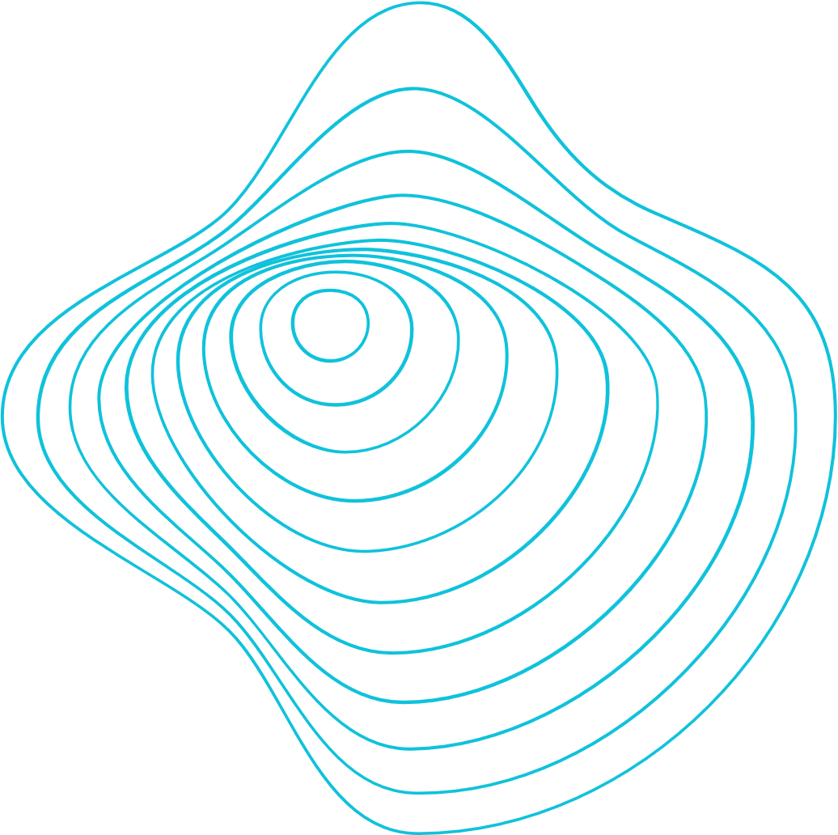
Purpose
The purpose is to develop an underwater robot which has the ability to move quietly and efficiently like fish, and to move in all directions like rotor robots to complete complex tasks and avoid disturbing other marine creatures, so as not to damage the environment.
1.
Mechanical structure of the robot
2.
Kinematic and Dynamic Model
3.
Control and Strategy Model
4.
Simulation and experimental results

Slide 4
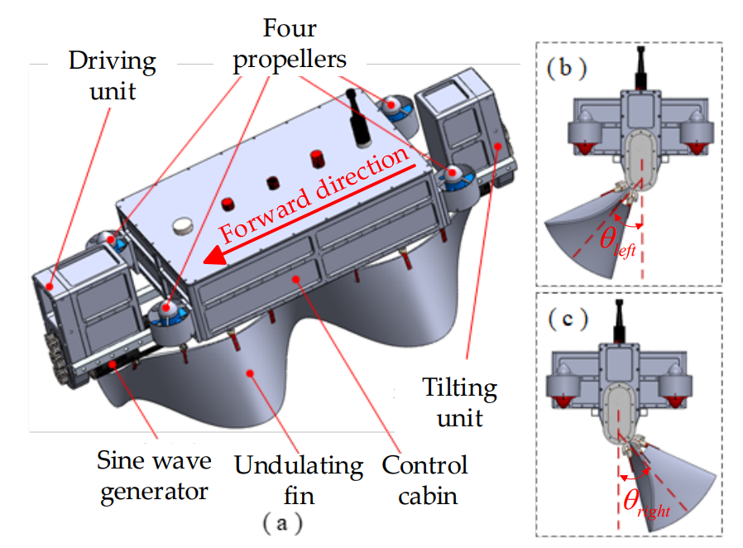
Robot description
The goal of our project is to design an operating robot that can move quietly and efficiently to its destination like a fish and then hover like a quadrotor robot.
The mechanical structure is composed of one cabin, four propellers, one undulating fin, one driving unit, one tilting unit, and one sine wave generator. The four propellers are configured as an X-type and installed vertically at the diagonal of the control cabin. The undulating fin is placed under the control cabin linking with the sine wave generator. It can tilt left and right around the central axis to generate horizontal propulsion and yaw moment.
(a) Design model of the underwater robot;
(b) Undulating fin tilts left side, θleft is tilting angel;
(c) Undulating fin right side, θright is tilting angle.

Slide 5

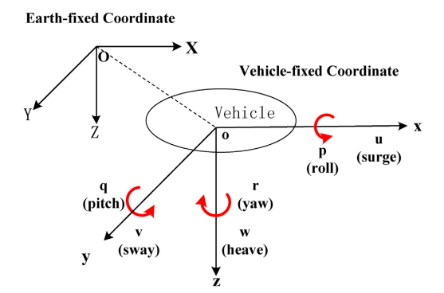
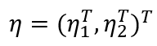
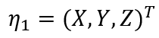
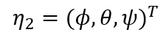
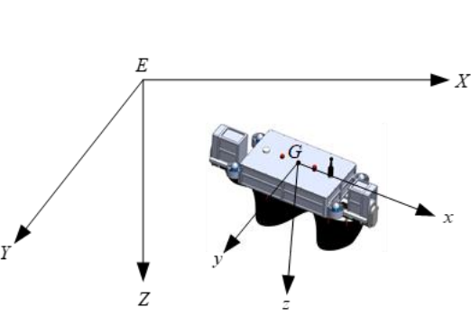
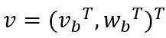
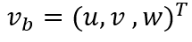
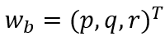
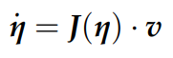
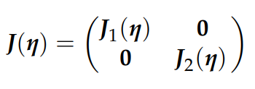
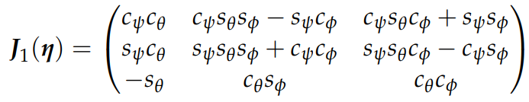
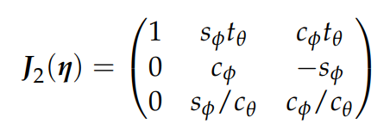
Kinematic Model
In the inertial coordinate system E-XYZ, the attitude of the robot is , where is the position of the robot and is the attitude angle of the robot.
The velocity of the robot in the body coordinate system
G-XYZ is where is the linear velocity and is the angular velocity.
The kinematic model of the robot can be given by:
Inertial coordinate system and robot coordinate system.
Where J is the velocity rotation matrix from robot coordinate system to inertial cordinate system, which is defined as:

Slide 6
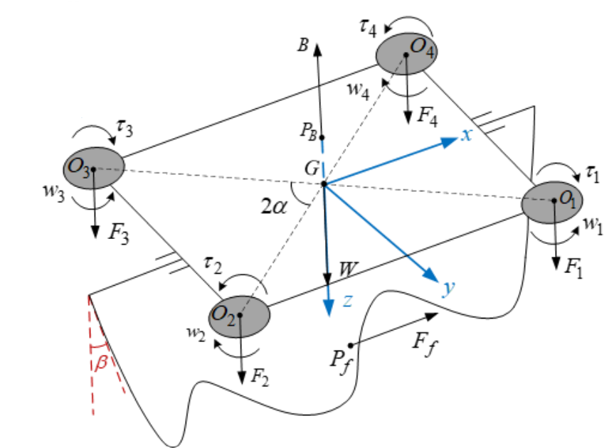
Dynamic Model
The robot is subjected to the combined action of gravity, buoyancy, propulsion of propellers, and undulating fin and resistence.
The weight force of the robot is W which acts on point G, the buoyancy is Pb. The thrust of propellers and counter torque are Fi , τi (i = 1, 2, 3, 4), respectively, and act on Oi (i = 1, 2, 3, 4) which is the centroid of each propeller.
The undulating fin can generate forward or backward thrust through sinusoidal motion, denoted as Ff and the action point Pf is taken at the center of the fin surface.
Dynamic model of the robot.

Slide 7
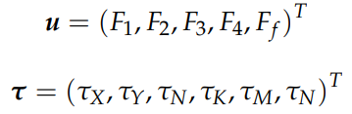
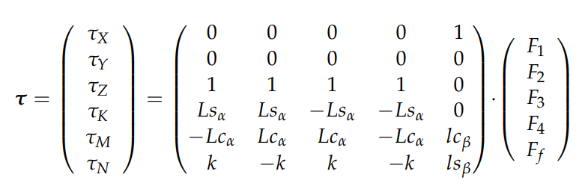
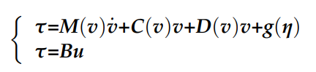
Equation of motion control
The control force matrix and 6-DOF control force of the robot are:
We define k as the proportional coefficient of propellers thrust and reverse torque, the 6-DOF control force can be solved as given by:
Under the combined action of robot control force, resistance, and resilience,
the dynamic mathematical model of the robot can be given by:

Slide 8
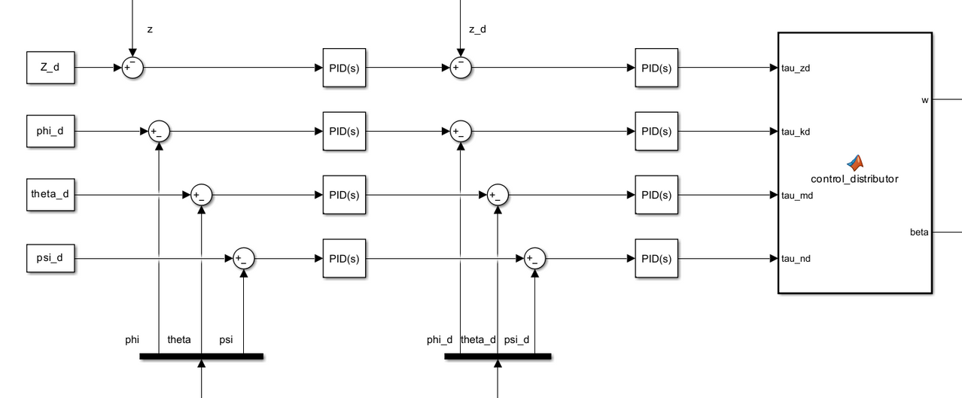
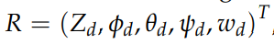
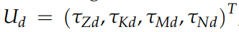
Control Model
During the movement of the underwater robot, due to the nonlinear and time-varying characteristics of the external water flow disturbance, the system is prone to oscillation and even instability.
To solve the case, the controller used is a 4-DOF cascade PID.
The reference input of the control system is composed of the expected value of depth and triaxial angle and the undulating frequency.
The output of the controller contains the expected vertical force, rolling torque, pitching torque, and yaw torque calculated by the four-channel controllers.

Slide 9

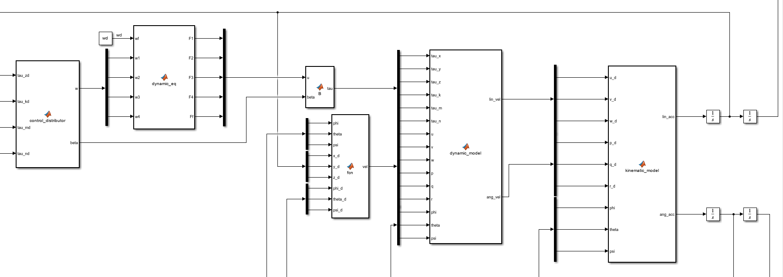
Control Model
A control distributor is introduced to convert the expected force and torque calculated by the controller into direct control parameters.
Proportional control distribution strategy to get the the tilting angle of the undulating fin.
The linear and angular acceleration of the robot in the geographical coordinate system is extracted from the kinematic matrix conversion.
Dynamic equations from which are retrieved the thrust of propellers and the forward or backward thrust generated by the undulating fin.
Matlab function from which it’s obtained the velocity of the robot using the inverse of Jacobian.
From the dynamical mathamatical model of the robot it’s obtained he motion decomposed into independent channels.

Slide 10
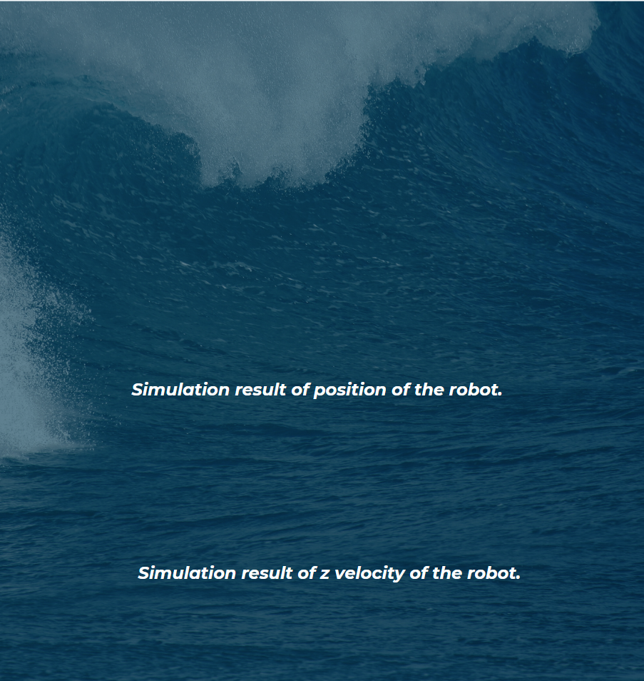
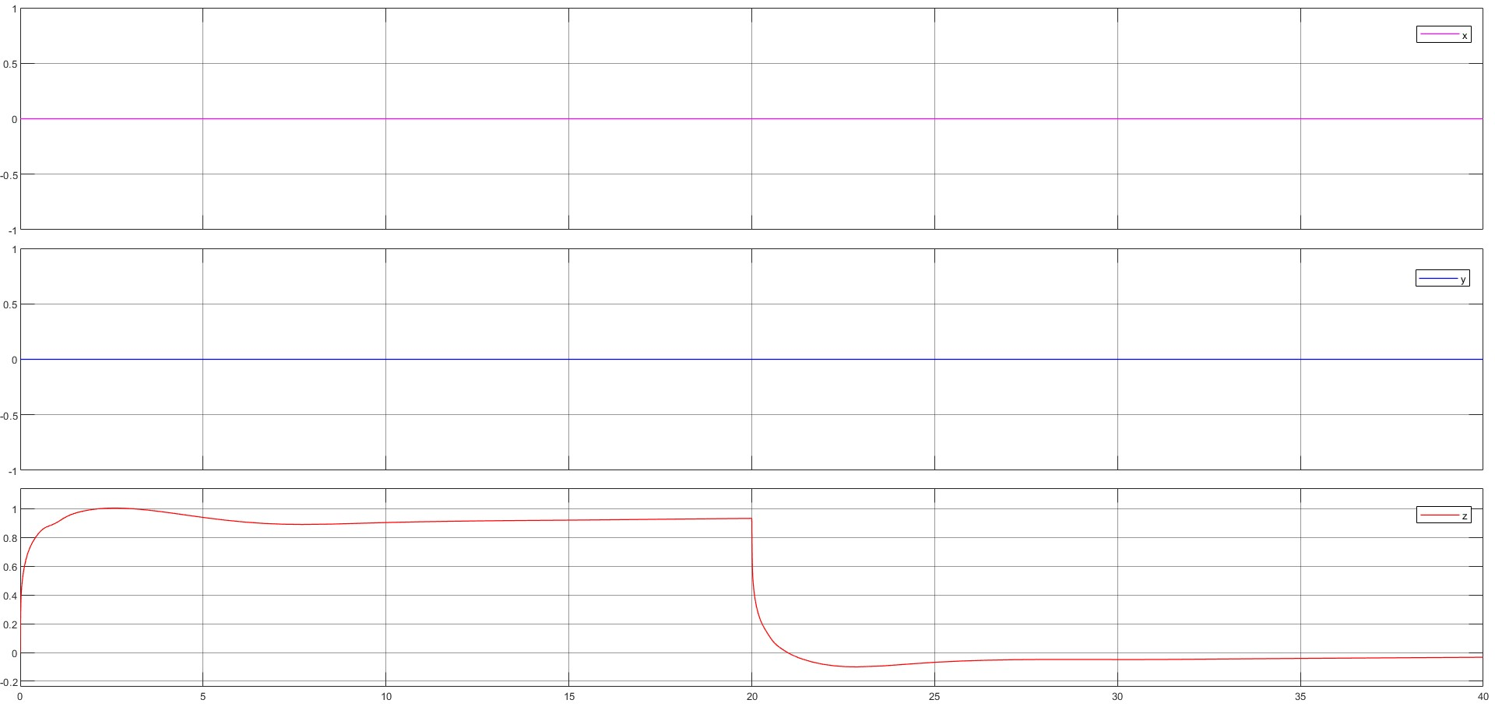
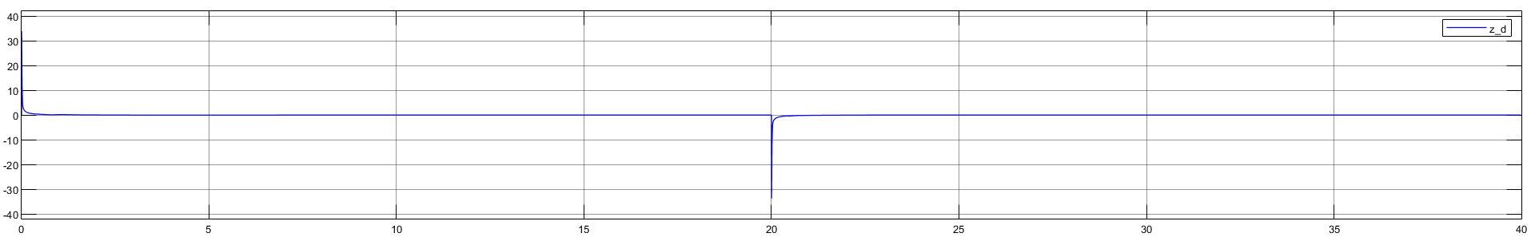
Simulations
Heave motion
In the heave motion simulation, the initial state of the robot is set to s = (0, 0, 0, 0, 0) , the reference input is set to R = (1, 0, 0, 0, 0) (t < 20 s) and R = (0, 0, 0, 0, 0) (t > 20 s).
The experimental results of heave movement show:
The X and Y position are stable to 0 and the Z position reaches the desired value in 15 seconds after a transient and with a negligible error in the order of 10e-2. Then the Z value returns to 0 at the second 30 after a transient, still with an error in the order of 10e-2.
The robot has good motion stability, the roll, pitch, and yaw angle of the robot remain stable during the process of descent, hovering, and floating.

Slide 11
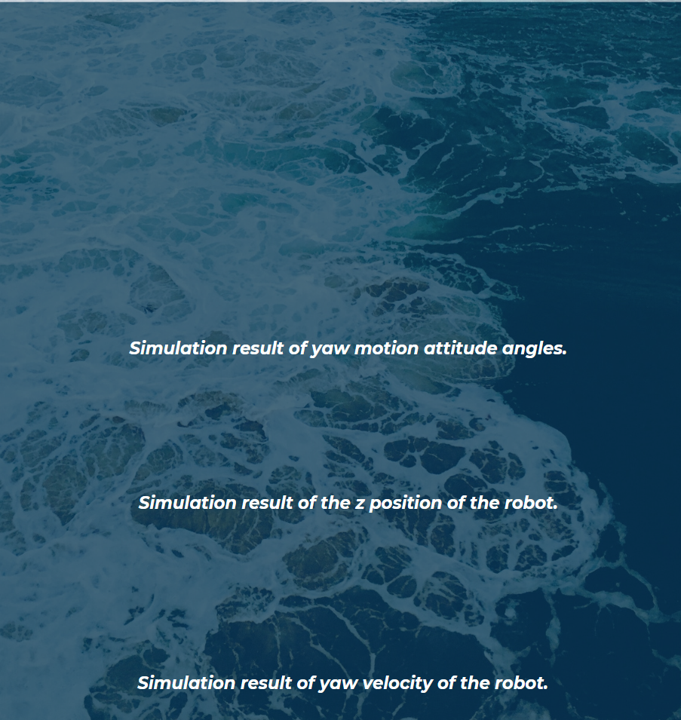
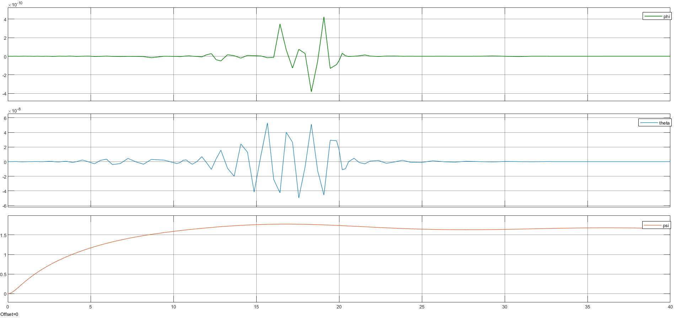
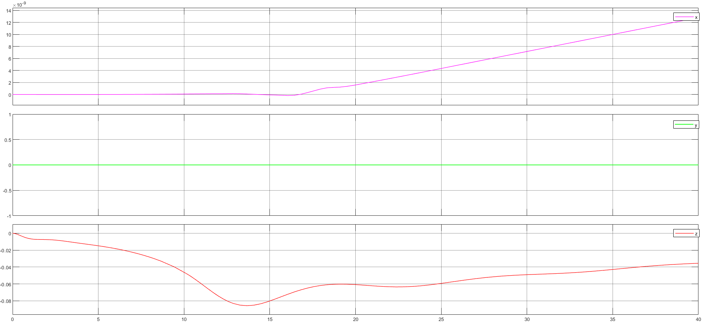
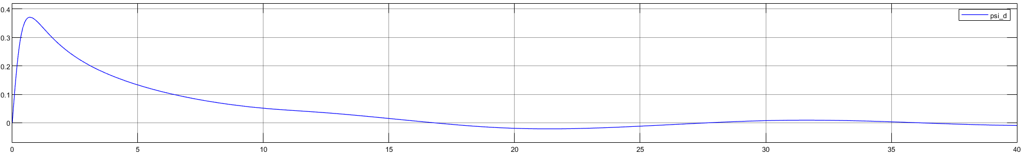
Simulations
Yaw motion
In the yaw motion simulation, the initial state of the robot is set to s = (0, 0, 0, 0, 0); and the reference input is set to R = (0, 0, 0, pi/2 , 0).
The simulation results are shown in figure.
The yaw angle has a transient and sets to the desired value of pi/2 in 25 seconds with a negligible error, which is less than +/-2° . The roll and pitch angle suffer of very little oscillations in the order of 10e-8 around the stable value of 0.
The robot achieves the desired value of yaw angle with a maximum spinning velocity of 0.37 rad/s.
The Z position also suffers of oscillations in the order of 10e-2 around the 0 value, whereas the X and Y positions are stable to 0.

Slide 12
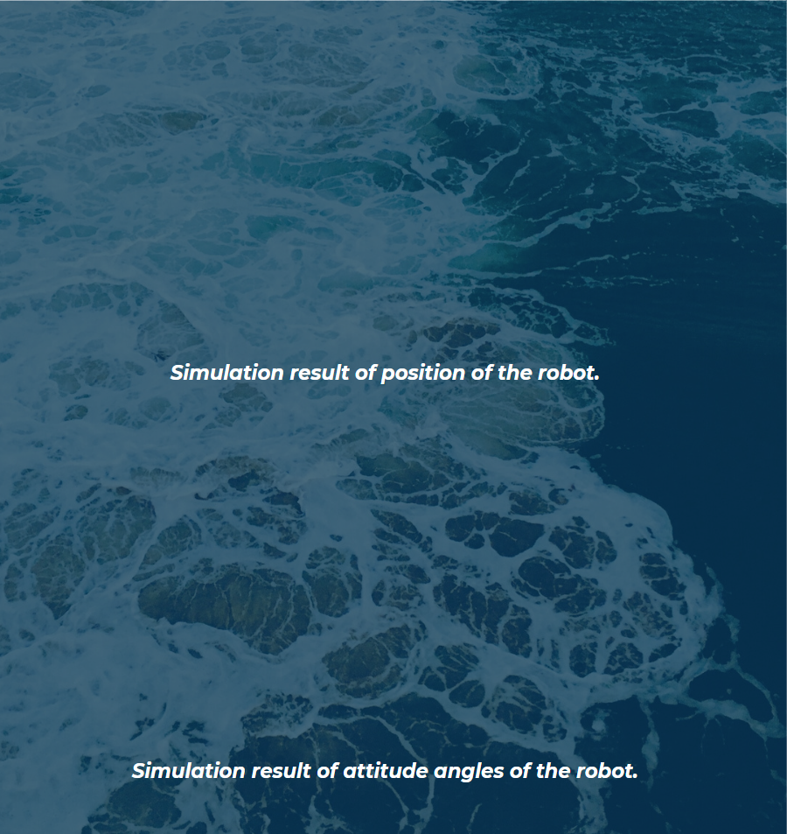
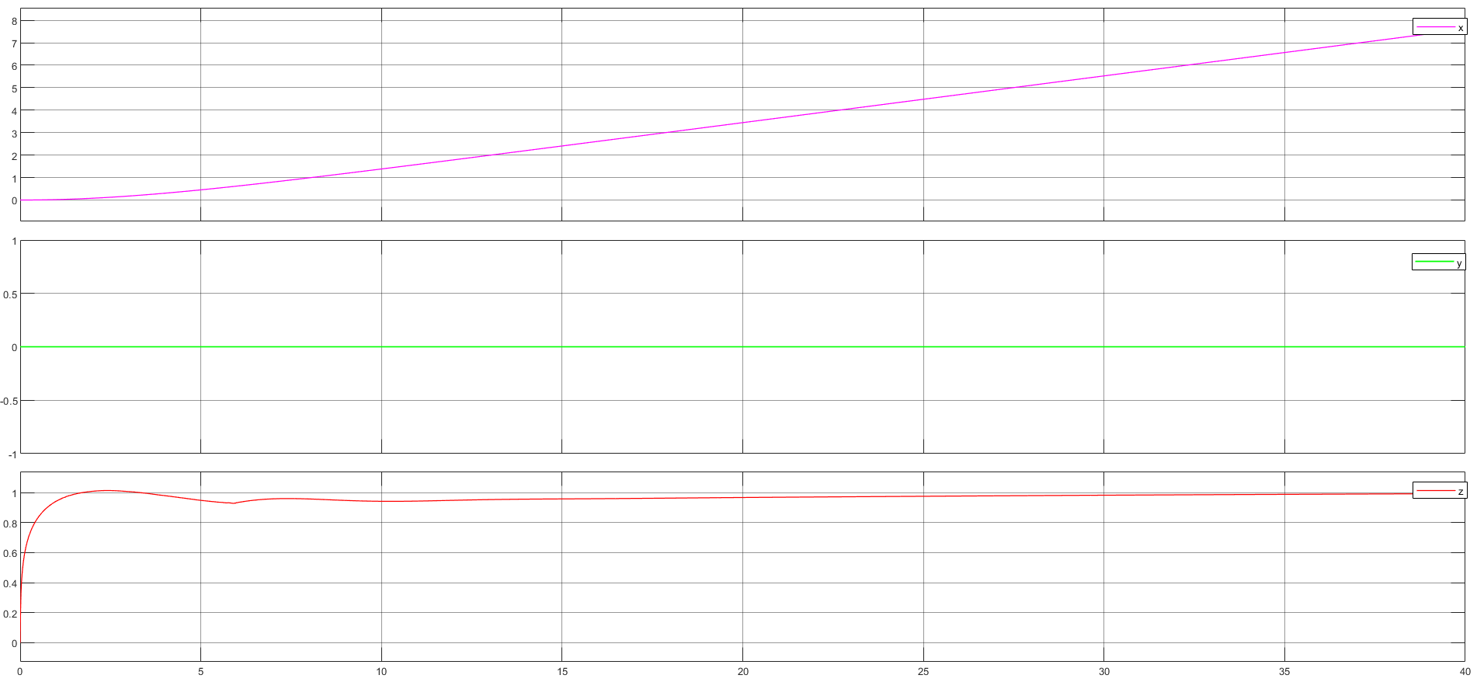
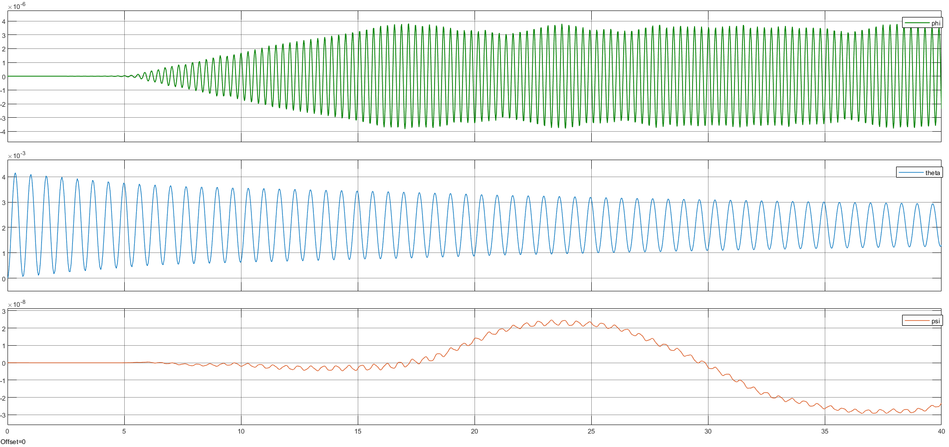
Simulations
Surge motion
In the surge motion simulation, the initial state of the robot is set to s = (0, 0, 0, 0, 0) and the reference input is set to R = (1, 0, 0, 0, 100).
The robot moves from the surface of the tank to a depth of 1 m and at the same time moves along the X-axis thanks to the undulating fin that undulates at a frequency of 2 Hz.
The Y position is stable to 0 and the Z position reaches the desired value of 1 after a transient and with a negligible error in the order of 10e-3.
The value of roll, pitch and yaw angle suffer of very little oscillations around the value 0, that are negligible.

Slide 13

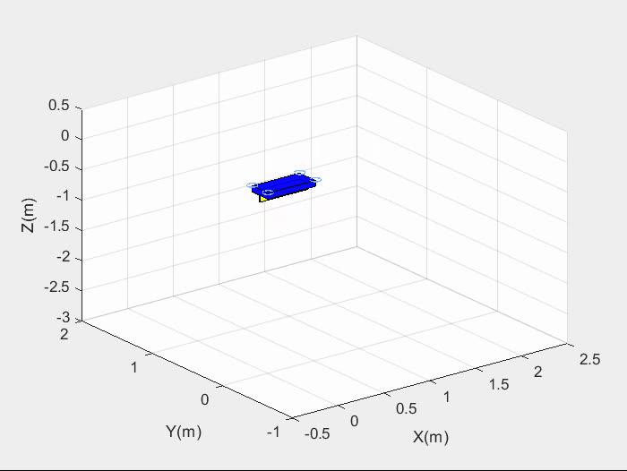
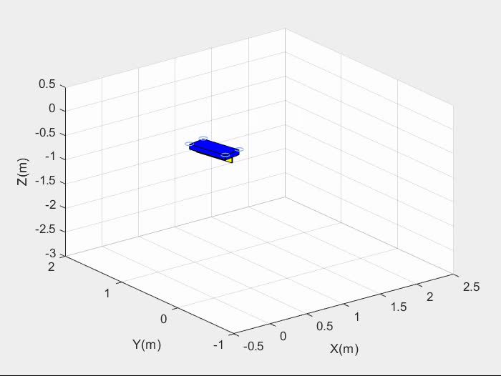
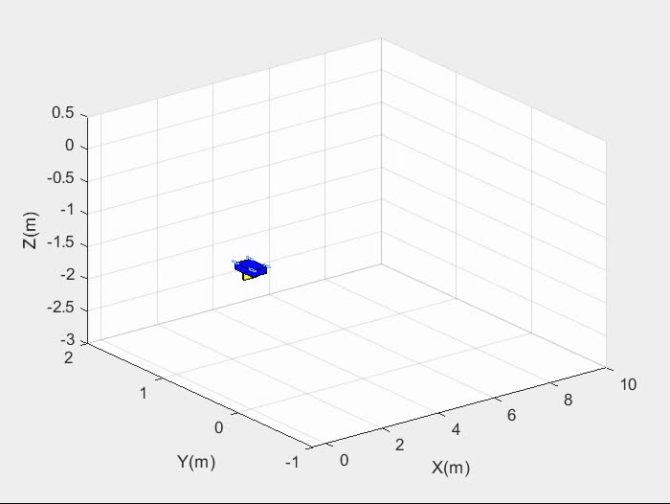
THE UNDERWATER MOTION PERFORMANCE OF THE ROBOT
HEAVE MOTION
YAW MOTION
SURGE MOTION

Slide 14

The present underwater robot prototype has successfully realized basic motion and high-frequency propulsion, which increase its suitability for a variety of tasks such as marine exploration, rescue and operation.
The shape of the robot can be designed to be fish-like in order to improve the hydrodynamic performances while the structure of the fin can be improved with soft material to generate an ideal sine wave.
Applicability and
improvement

Slide 15
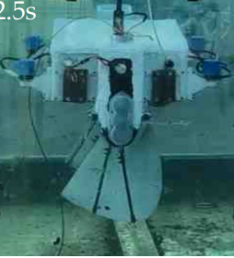
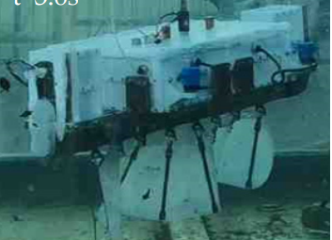
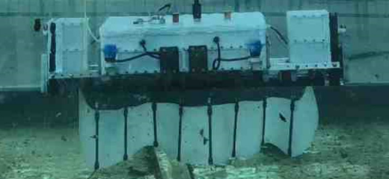
Thank you for your attention !

